Slide 1
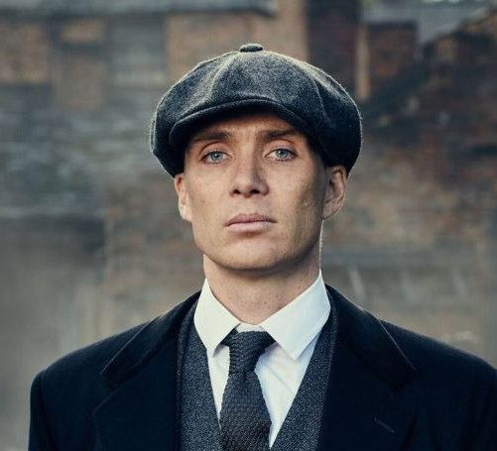
Peaky Blinders

Slide 2
Peaky Blinders
Tommy Shelby is the younger brother but is the gang leader of ‘Peaky Blinders’ and has help from his friends and family. He is notorious for having problems with the law and other gangs and goes head to head against them and always puts himself first and helps everyone out but over time he begins to get disliked by his family and home town.
Main Actors/Actresses
-Cillian Murphy (Tommy Shelby)
-Helen McCrory(Polly Grey)
-Paul Anderson(Arthur Shelby)

Slide 3
Peaky Blinders Equipment
Peaky Blinders was filmed with Arri Alexa Cooke Anamorphic Prime Lenses Cooke S4/i Prime Lenses RED Weapon 8K VV Monstro
They used a aspect ratio of 16:9
Sound mixer was a ADR mixer
Shot in colour

Slide 4
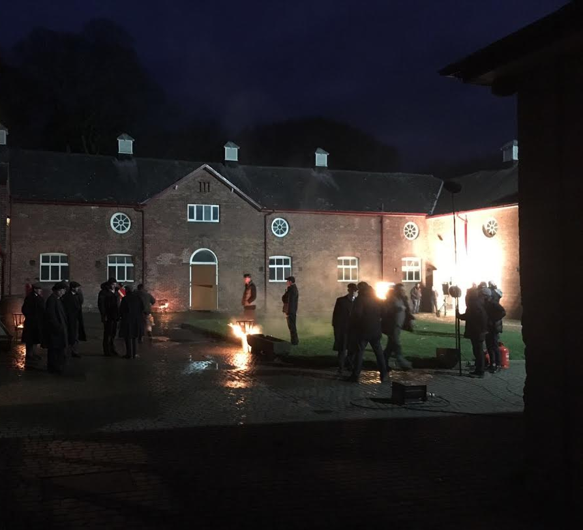
Peaky Blinders Lighting
A lot of areas they filmed was dark and wet so lighting was key in a lot of shots they used a arrange of lights these would be on small cranes and on industrial tri pods
This is a photo of the shot they films outside in the dark

Slide 5
Peaky Blinders Sound
The sound on Peaky Blinders are very loud especially during shot outs of arguments but they balance this well with a ADR mixer especially with the od gun noises
Effects such as transferring the main music to radio were used in the sound mixing
Gunshots
Cars
Matches being lit
This was very effective and made Peaky Blinders even better

Slide 6
Peaky Blinders Editing
A lot of editing was done during this such as adding old building into the background and small smoke details
Cause it was shot on a RED camera the footage would be RAW format (R3D) this will give the ability to fix mistakes for example adjusting ISO
The colour grading
The characters all wear suits and have a dark colour wardrobe from blacks to browns giving a grim look this works well in editing
Editing is one of there key elements as they need to add in a lot of sound and background

Slide 7
Peaky Blinders Scripting
The script of Peaky Blinders takes a long time to developed as they need to use old slang and deep talk especially with gangs and the police
There is no crossovers as of now
To keep up to date you need to watch from season 1 episode 1 unlike some for example you could watch The Simpsons from any season and any episode

Slide 8
Peaky Blinders Rewiews
Sources
https://www.google.com/search?biw=909&bih=810&sxsrf=ACYBGNT-fNm8n1UsEZJfsWwIqtnGChAiRA%3A1575994135736&ei=F8PvXZrLLL6H1fAPycuHgAc&q=peaky+blinders+review&oq=peaky+blinders+rew&gs_l=psy-ab.3.0.0i10l10.1522.1958..3281...0.1..0.123.281.2j1......0....1..gws-wiz.......0i71j0i131j0.J1EvlAuivkE
https://www.rottentomatoes.com/tv/peaky_blinders

Slide 9
Peaky Blinders Audience Classification

Slide 10
Peaky Blinders Audience Classification
Peaky Blinders is a viewing age of 18+ due to drugs, violence and language
It is not recommended for viewers under 18 years of age

Slide 11
Peaky Blinders Merchandise
There a arrange of Merchandise for Peaky Blinders due to its popularity this will help fund the new seasons.
This is official merch

Slide 12
Peaky Blinders Complaints

Slide 13
Peaky Blinders Quality and Standards
The overall quality of Peaky Blinders stays very consistent throughout the entire series, the colour grading style is consistence and has kept this for all 5 seasons as of now and hopefully in season 6 it will continue.

Slide 14
Peaky Blinders Tastes and Decency's
Peaky blinder is a very excellent series and well put together but is not for everyone as its rivals with the police an is very violent and gory and some characters abuse drugs this would be a put off for some viewers , I really enjoy it as it shows growth in gangs and also the falls and loop holes they find.

